Slide 1
Expression detection system Enhanced with Age, Gender Recognition and Database Integration
Group
7010
GUIDE:
MR. YOGI REDDY MARAMREDDY
ASSISTANT PROFESSOR, COMPUTER SCIENCE AND ENGINEERING, GST , HYDERABAD

Slide 2
OVERVIEW
SCOPE
The Age-Gender-Emotion Prediction project aims to develop a system or model that can predict the age, gender, and emotional state of individuals based on various input sources such as images, videos, or text.
Importance of incorporating age and gender recognition for a more nuanced understanding of emotions. Necessity to store data in a database for future analysis and longitudinal tracking.
EXPRESSION DETECTION SYSTEM
APPLICATIONS
MARKETING AND ADVERTISING
CUSTOMER EXPERIENCE
HEALTHCARE
EDUCATION
HUMAN-COMPUTER INTERACTION (HCI)
SECURITY AND SURVEILLANCE
ENTERTAINMENT AND GAMING
2

Slide 3
Datasets
FER2013
Number of Images: FER2013 contains a total of 35,887 images of faces, providing a diverse and comprehensive set of samples.
Emotion Categories: The dataset includes seven emotion categories: Angry, Disgust, Fear, Happy, Neutral, Sad, and Surprise. These categories encompass a wide range of human emotions, making it suitable for training a robust emotion detection model.
EXPRESSION DETECTION SYSTEM
UTKFACE
The UTKFace dataset is a large-scale face dataset with long age span (range from 0 to 116 years old). The dataset consists of over 20,000 face images with annotations of age, gender, and ethnicity. The images cover large variation in pose, facial expression, illumination, occlusion, resolution, etc. This dataset could be used on a variety of tasks, e.g., face detection, age estimation, age progression/regression, landmark localization, etc.
3

Slide 4
FLOWCHART
INPUT
LIVE FEED
PRE-PROCESSING
FACIAL FEATURE EXTRACTION
NEURAL NETWORK
TRAIN AND TEST
CNN
IMAGE
DETECTION
EMOTION
AGE
GENDER
STORING & ANALYSIS
DATABASE
TIME-TO-TIME FEED
RESULT
DISPLAY LIVE FEED WITH REQUIREMENTS

Slide 5



METHODOLOGIES
WEBCAM
IMPLEMENTATION
DATABASE INTEGRATION
CNN MODELS

Slide 6



CNN models
This Photo by Unknown Author is licensed under CC BY-NC

Slide 7
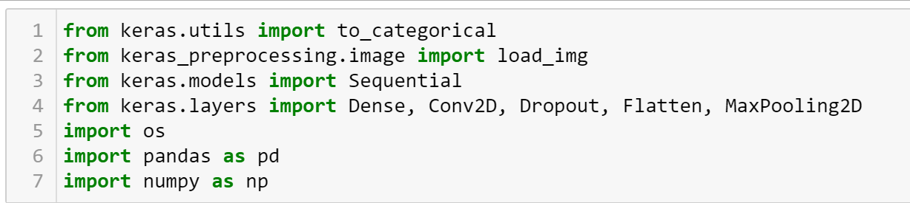
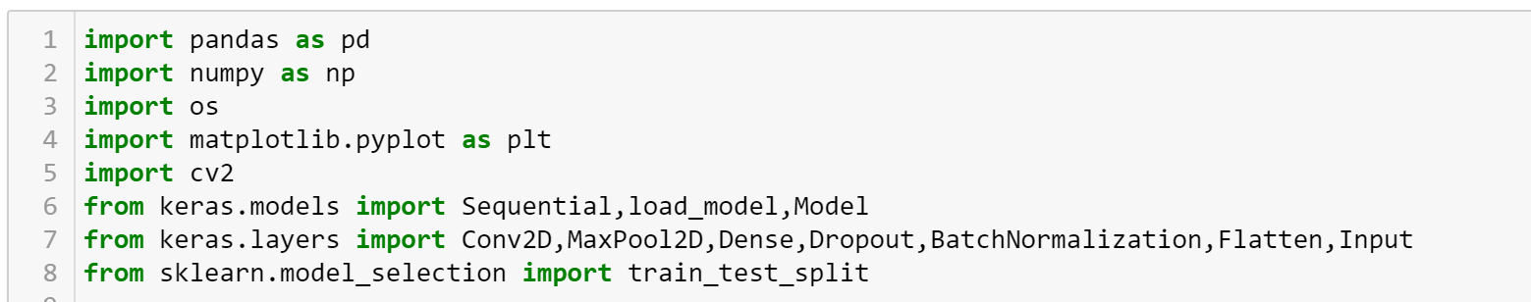
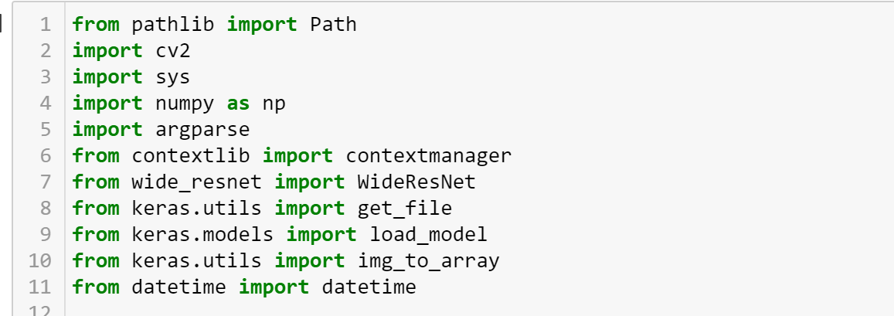
LIBRARIES USED
EMOTION MODEL
AGE-GENDER MODEL
DRIVER

Slide 8
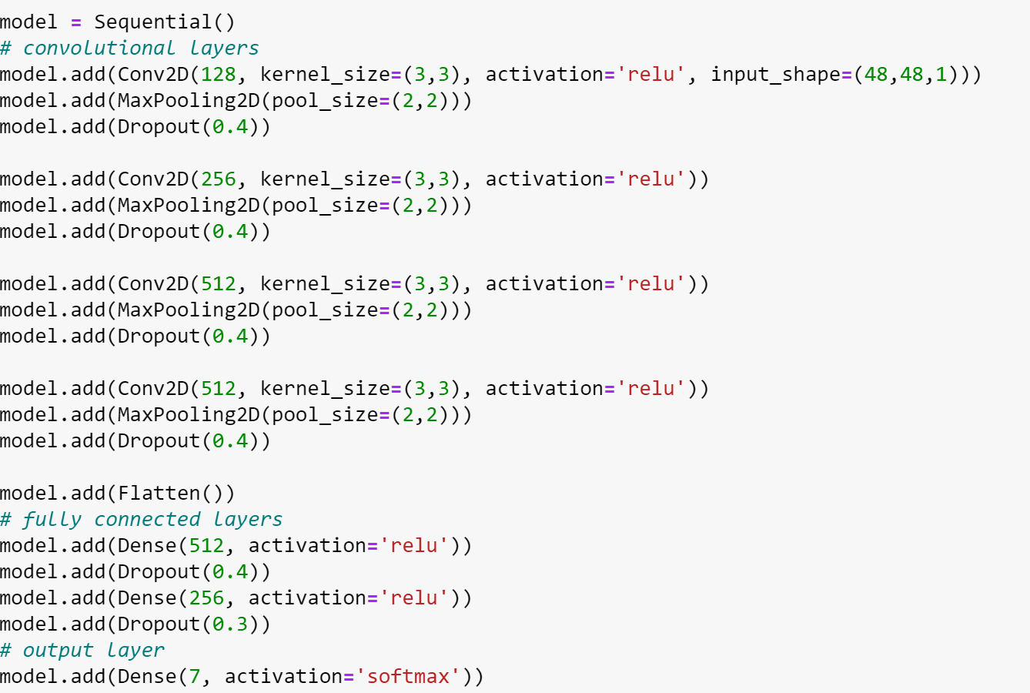
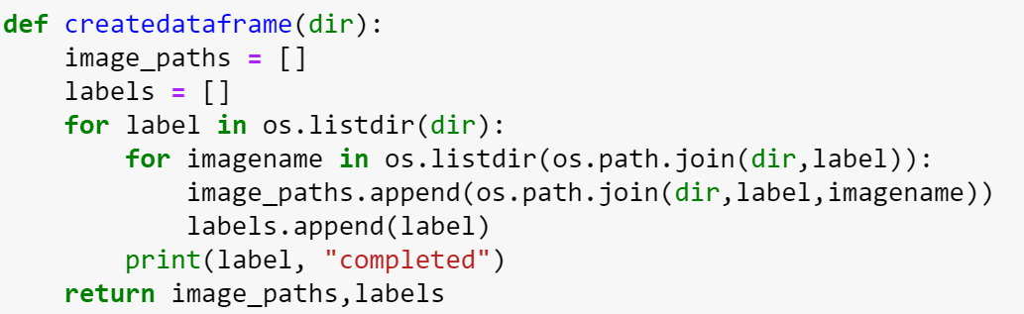
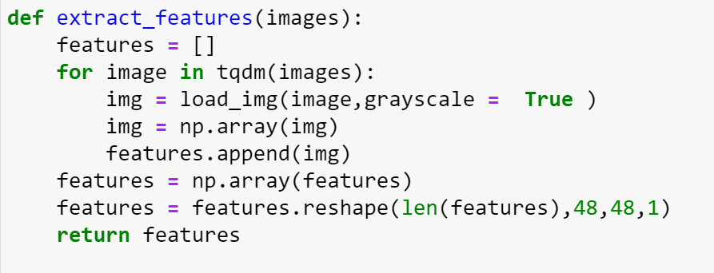
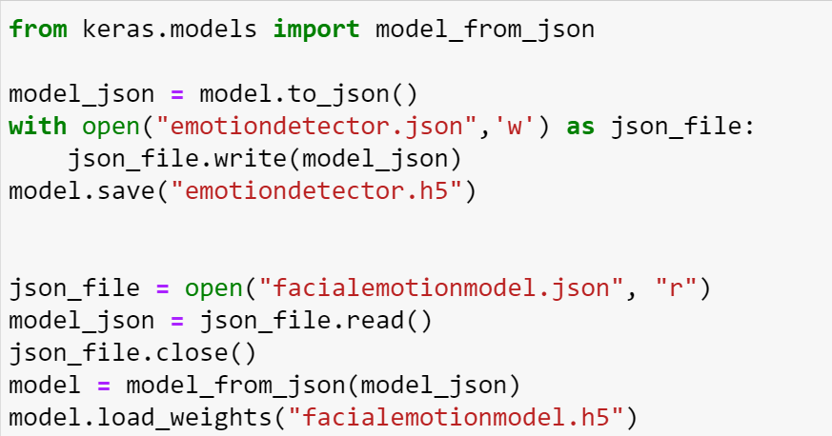
EMOTION MODEL
DATAFRAME CREATION
NEURAL NETWORK
FEATURE EXTRACTION
SAVING FEATURES

Slide 9
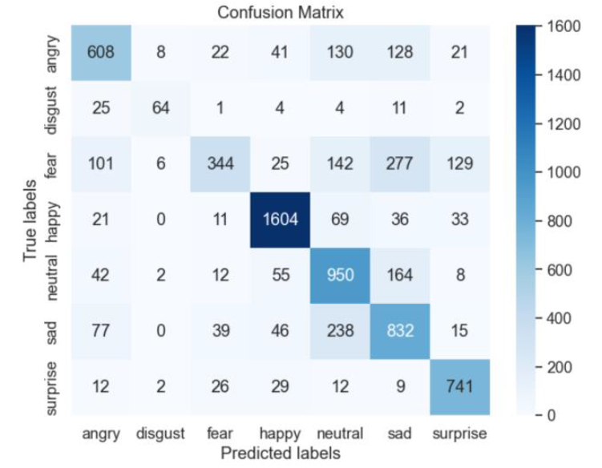
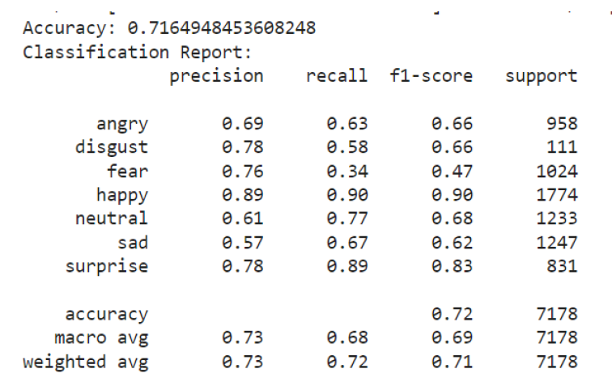
METRICS
EMOTION MODEL
ACCURACY &
CLASSIFICATION REPORT
CONFUSION MATRIX

Slide 10
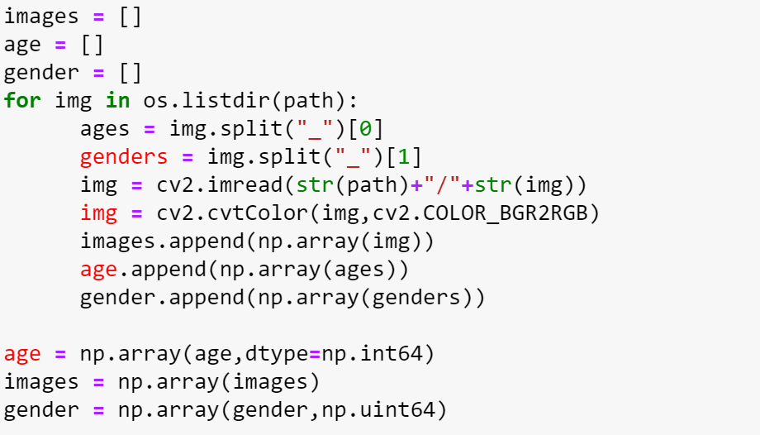
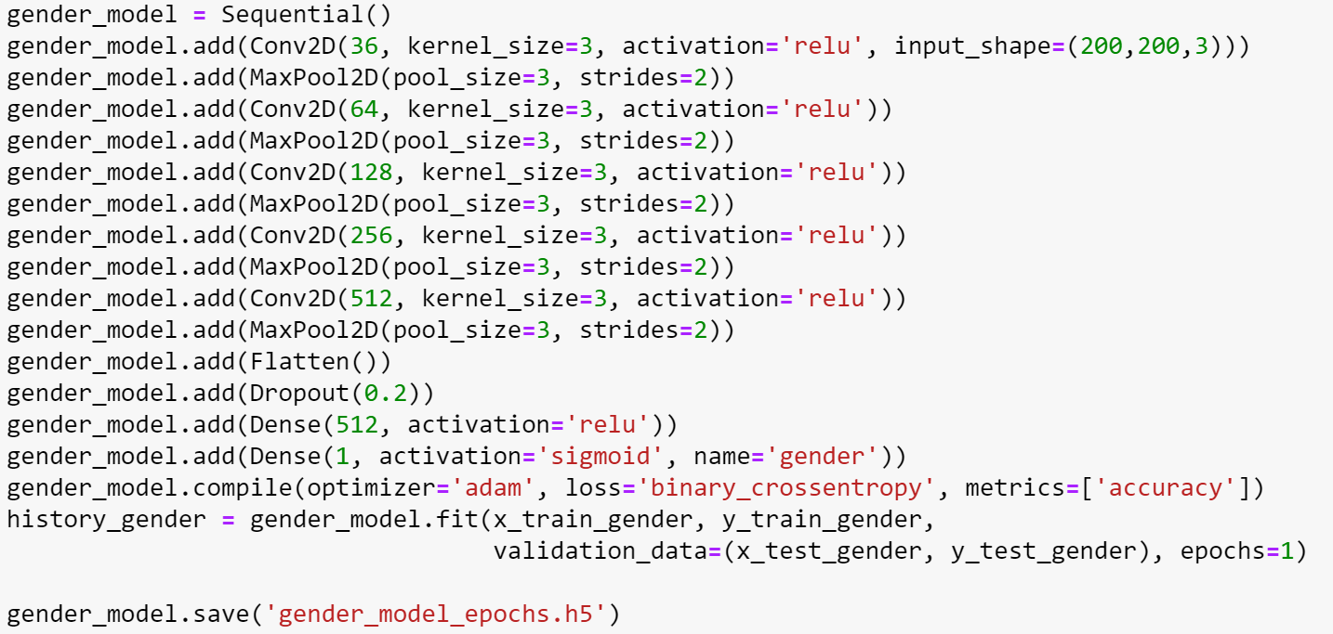
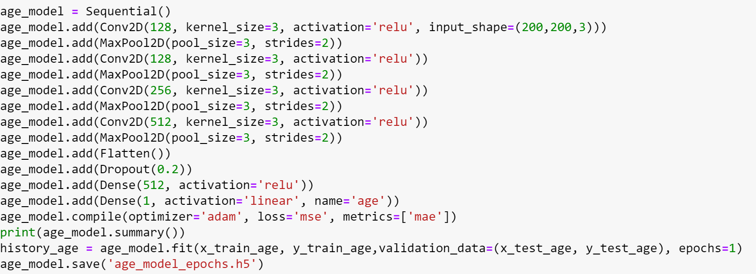
AGE-GENDER MODEL
DATAFRAME CREATION
NEURAL NETWORK &
SAVING FEATURES

Slide 11
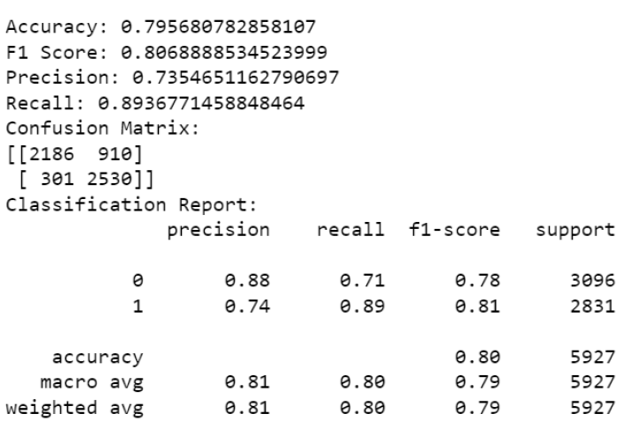
METRICS
AGE-GENDER MODEL
ACCURACY
F1 SCORE
PRECISION
RECALL
CONFUSION MATRIX
CLASSIFICATION REPORT

Slide 12



WEBCAM IMPLEMENTATION
VIDEO INPUT ACQUISITION
FACE DETECTION AND LOCALIZATION
FEATURE EXTRACTION
EMOTION RECOGNITION MODEL
REAL-TIME FEEDBACK AND VISUALIZATION
CONTINUOUS MONITORING AND ANALYSIS

Slide 13
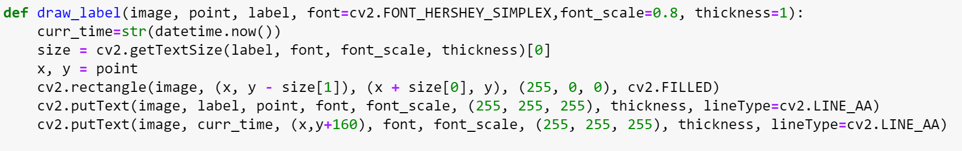
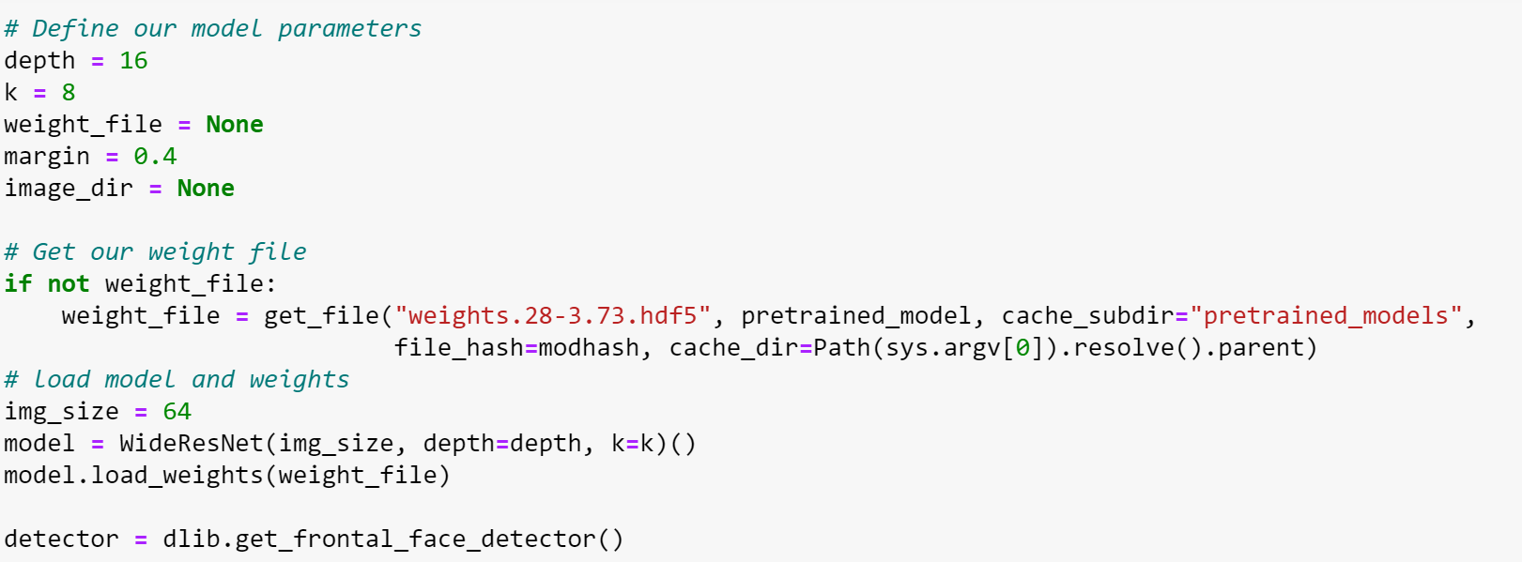
DRIVER CODE
INTERFACE CODE
LOADING MODEL WEIGHTS

Slide 14
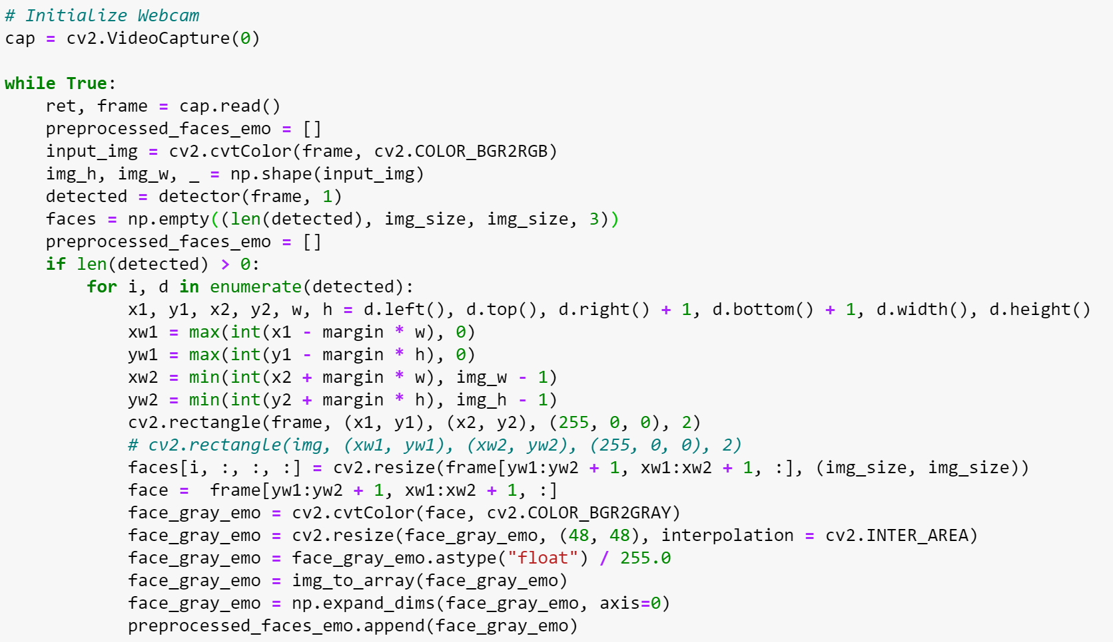
DRIVER CODE
DETECTING AND LABELLING

Slide 15
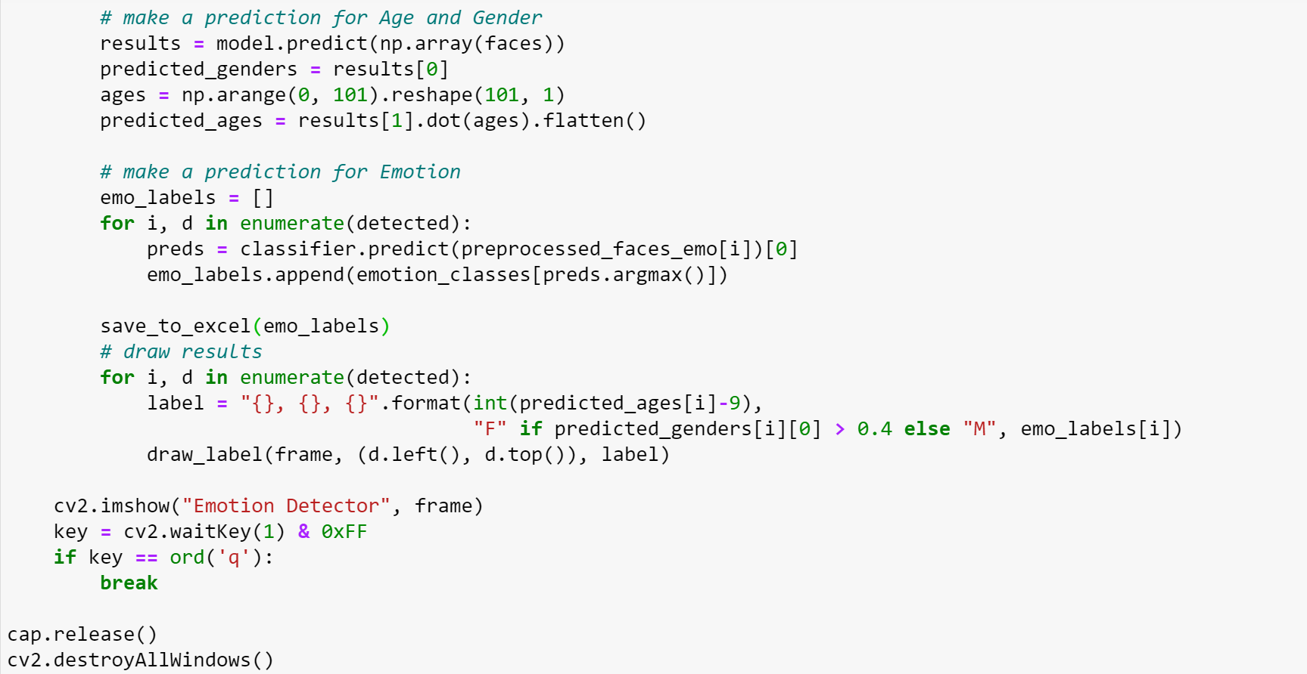
DRIVER CODE
PREDICTION AND SAVING

Slide 16
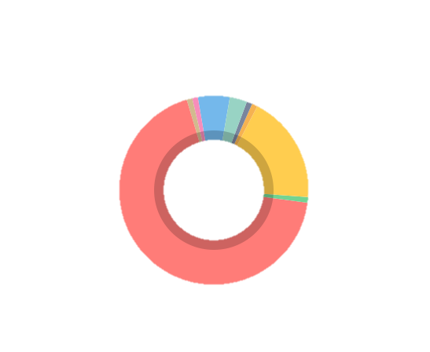


DATABASE INTEGRATION
EMOTION ANALYSIS INTEGRATION
TIMESTAMP INCLUSION
ENHANCED DATA VISUALIZATION
ACTIONABLE INSIGHTS
CONTINUOUS IMPROVEMENT
EXPRESSION DETECTION
16

Slide 17
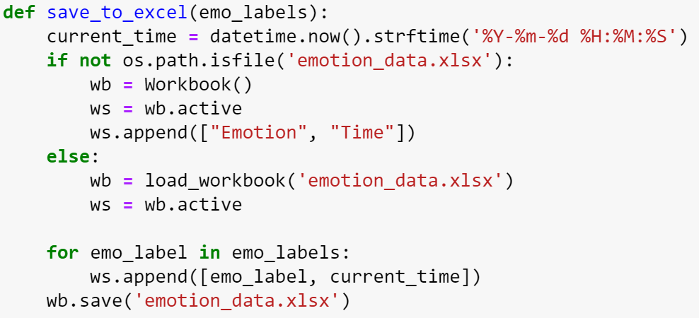
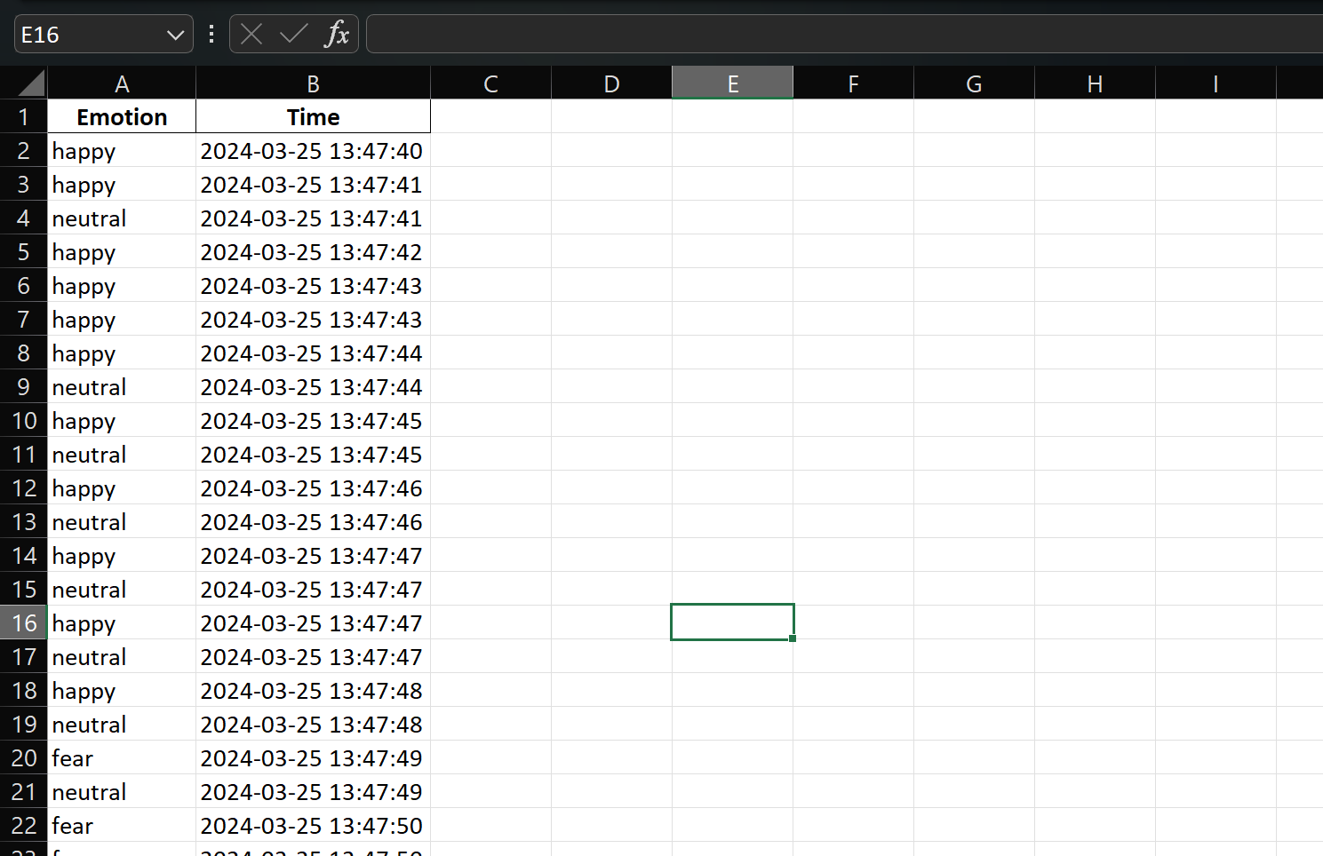
DATABASE INTEGRATION
SAVING TO EXCEL (DATABASE)
DISPLAYING THE DATA FOR FURTHUR ANALYSIS

Slide 18
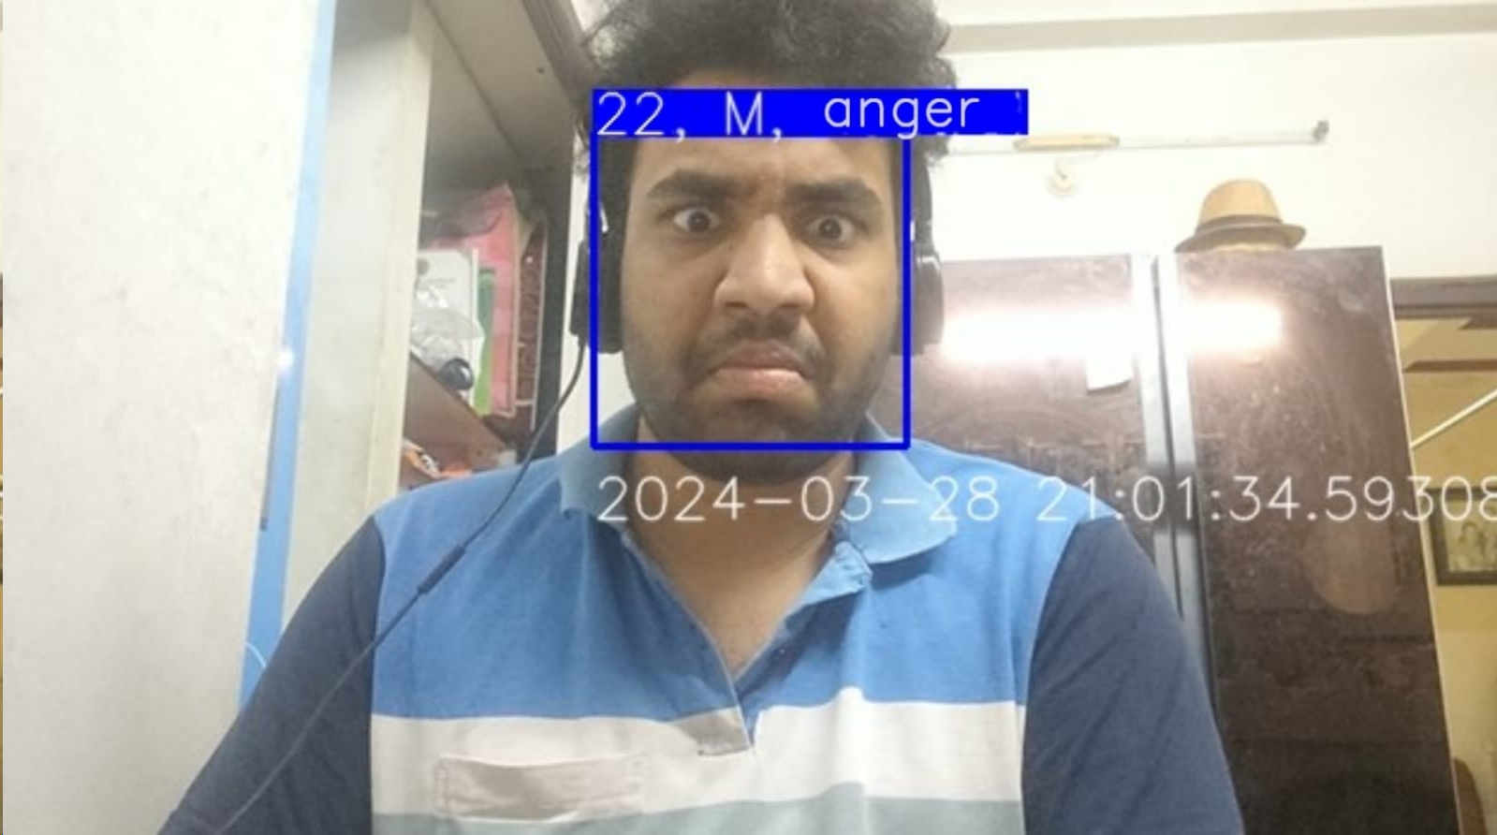
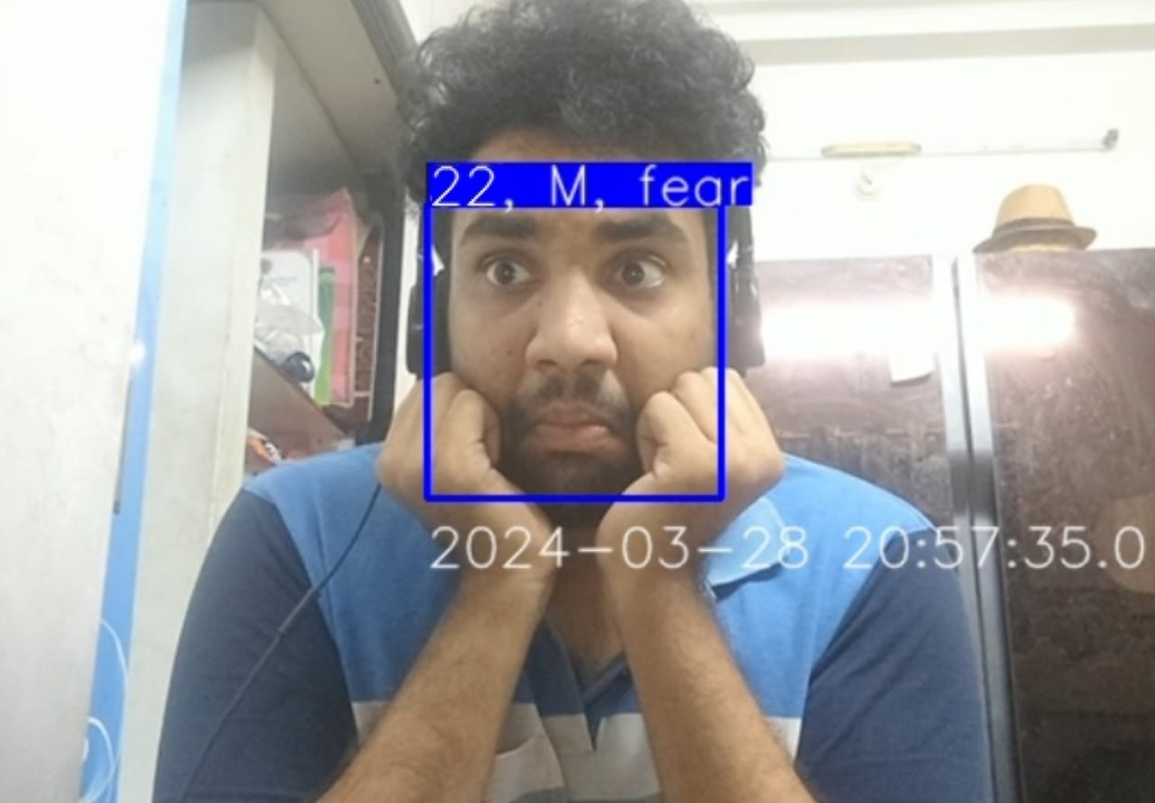
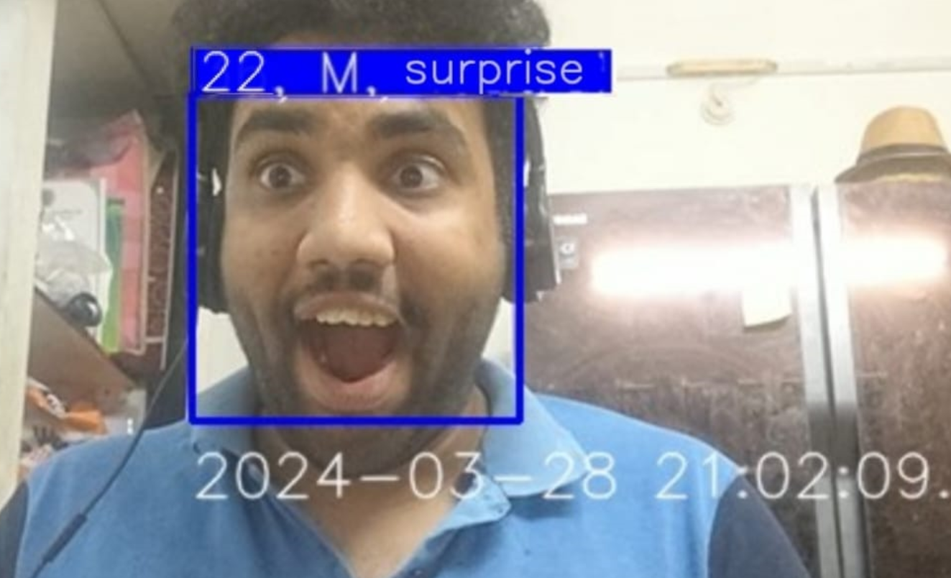
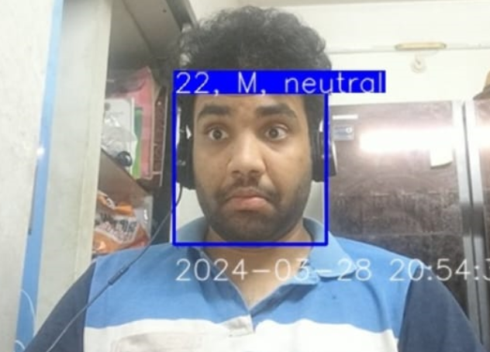
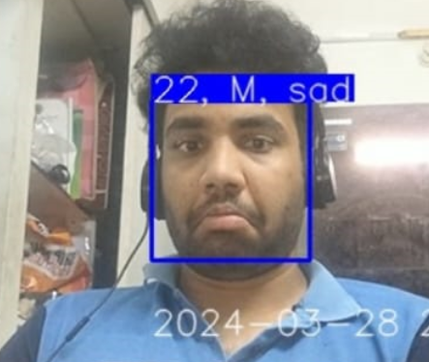
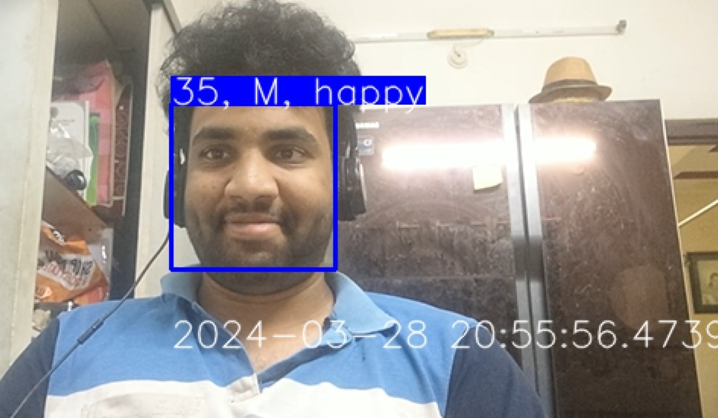
ANGER
FEAR
SURPRISE
RESULTS
NEUTRAL
SAD
HAPPY

Slide 19
ADVANCEMENTS
IMPROVE ACCURACY AND FRAME RATE
CLOUD BASED DATABASE
EXTENDING SYSTEM TO BEHAVIOURAL ANALYSIS
CAN ADD AUDIO MODELS FOR BETTER ANALYSIS
ETHICAL CONSIDERATION

Slide 20
CONCLUSION
OUR PROJECT MARKS A SIGNIFICANT MILESTONE IN THE REALM OF FACIAL EXPRESSION ANALYSIS AND RECOGNITION, AMPLIFIED BY THE INTEGRATION OF AGE AND GENDER RECOGNITION CAPABILITIES AND SEAMLESS DATABASE INTEGRATION USING EXCEL.
THIS MULTIFACETED SYSTEM EMBODIES A SYNERGY OF STATE-OF-THE-ART TECHNOLOGIES AND METHODOLOGIES, PROVIDING A ROBUST FOUNDATION FOR UNRAVELING THE COMPLEXITIES OF HUMAN EMOTIONS AND DEMOGRAPHICS.

Slide 21
REFERENCES
[1] Deep Learning Approach For Human Emotion-Gender-Age Recognition by Suraj S, Department of Computer science & Engineering , PES University Bangalore, India
[2] John, Ansamma, M. C. Abhishek, Ananthu S. Ajayan, S. Sanoop, and Vishnu R. Kumar. "Real-Time Facial Emotion Recognition System With Improved Preprocessing and Feature Extraction." In 2020 Third International Conference on Smart Systems and Inventive Technology (ICSSIT), pp. 1328 1333. IEEE, 2020.
[3] Noroozi, Fatemeh, Marina Marjanovic, Angelina Njegus, Sergio Escalera, and Gholamreza Anbarjafari. "Audio-visual emotion recognition in video clips." IEEE Transactions on Affective Computing 10, no. 1 (2017): 60-75.
EXPRESSION DETECTION​ SYSTEM

Slide 22
THANK YOU
J RUSHIL MANIDHAN 222010303042
PVN JAYANTH RAJ
222010303048
K RUTHVICK
222010303054
G SUPRITHA
222010303058
|
|
GROUP 7010
EXPRESSION DETECTION​ SYSTEM

